Slide 1


Slide 2
Content:
1. The Case
2. Current orthodox algorithms
Results
3. Current Unorthodox algorithms
Results
4. Joined effort

Slide 3
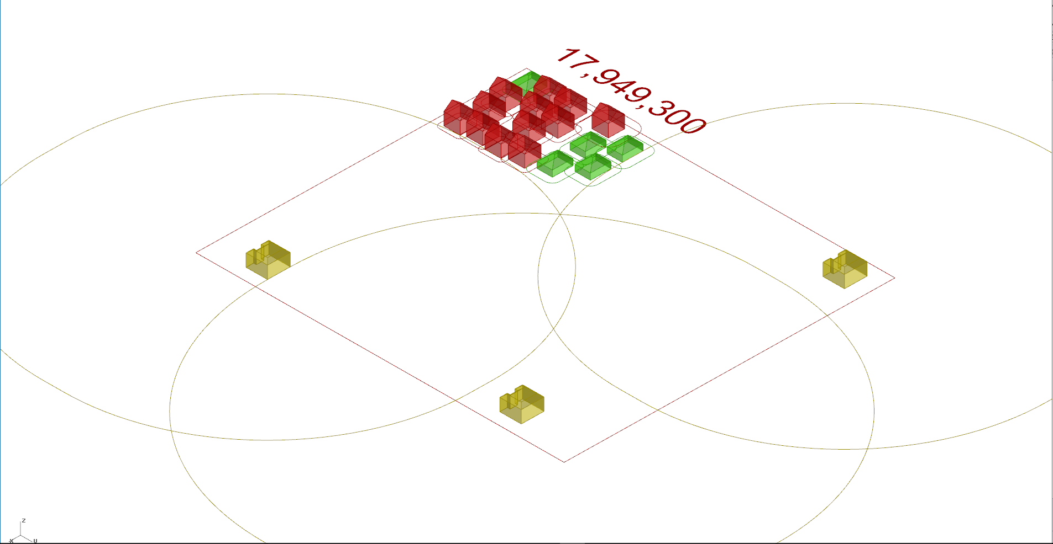
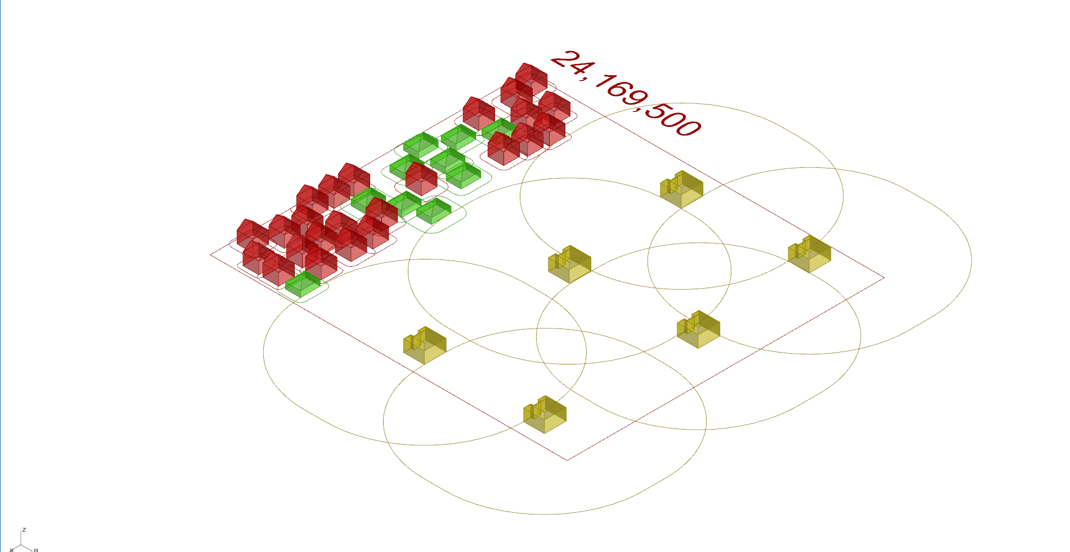
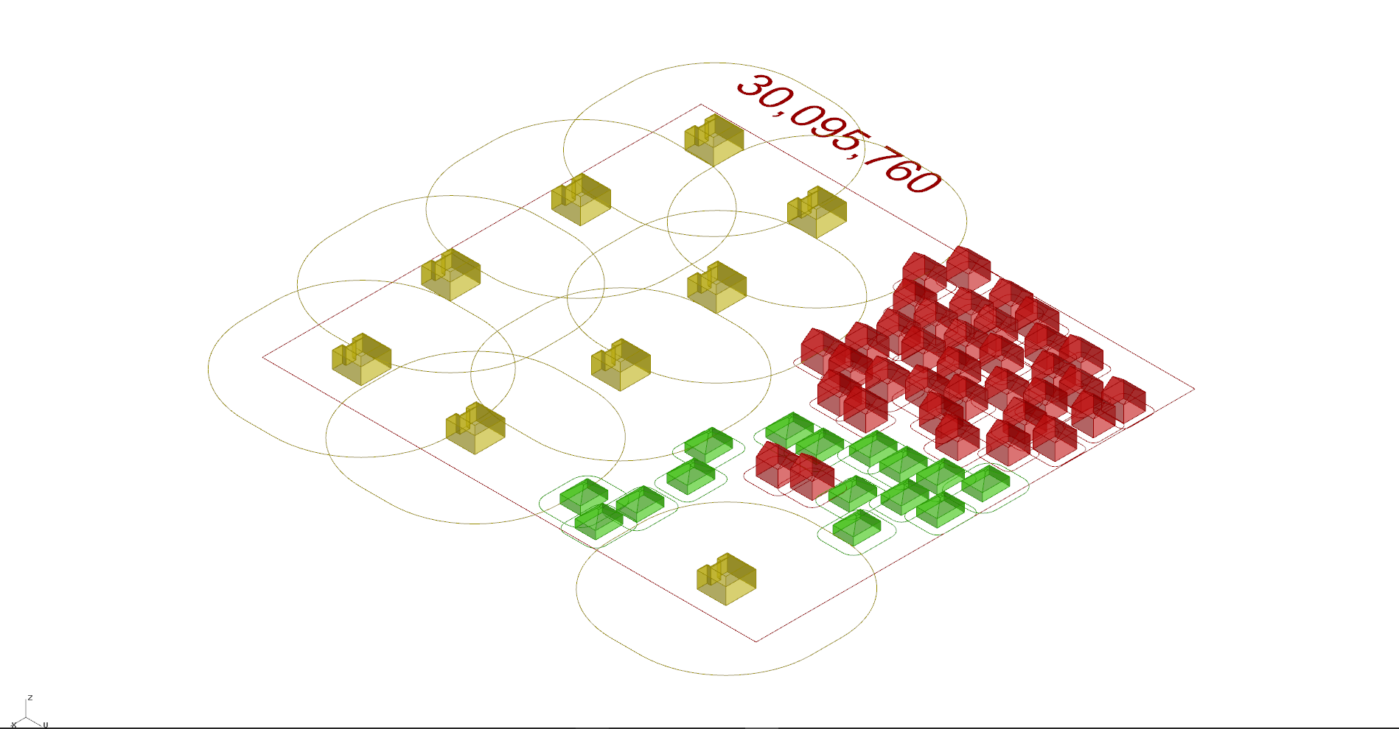
1. The case
A map of 180*160(m) needs to be filled with 20, 40 or 60 houses
Make the most valuable configuration

Slide 4
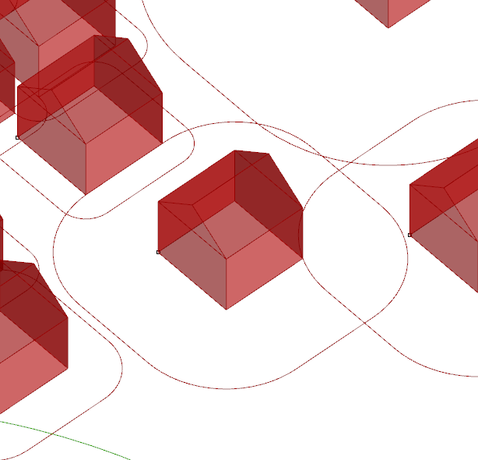
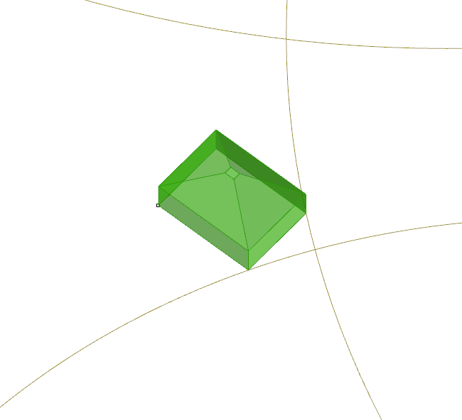
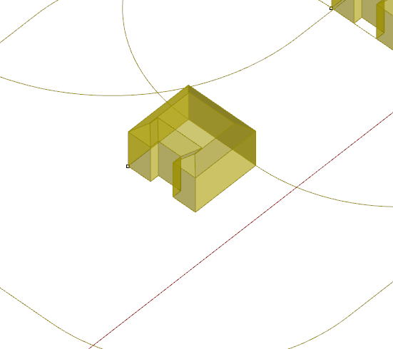
1. The case: details
3 values of house types:
Family home € 285.000, - 60 %
Bungalow € 399.000, - 25 %
Mansion € 610.000, - 15 %
State space lower bound (minimum map value):
per house-type: ((total n houses * frequencies) * their values)
20 houses: € 7.245.000, -
40 houses: € 14.490.000, -
60 houses: € 21.735.000, -

Slide 5
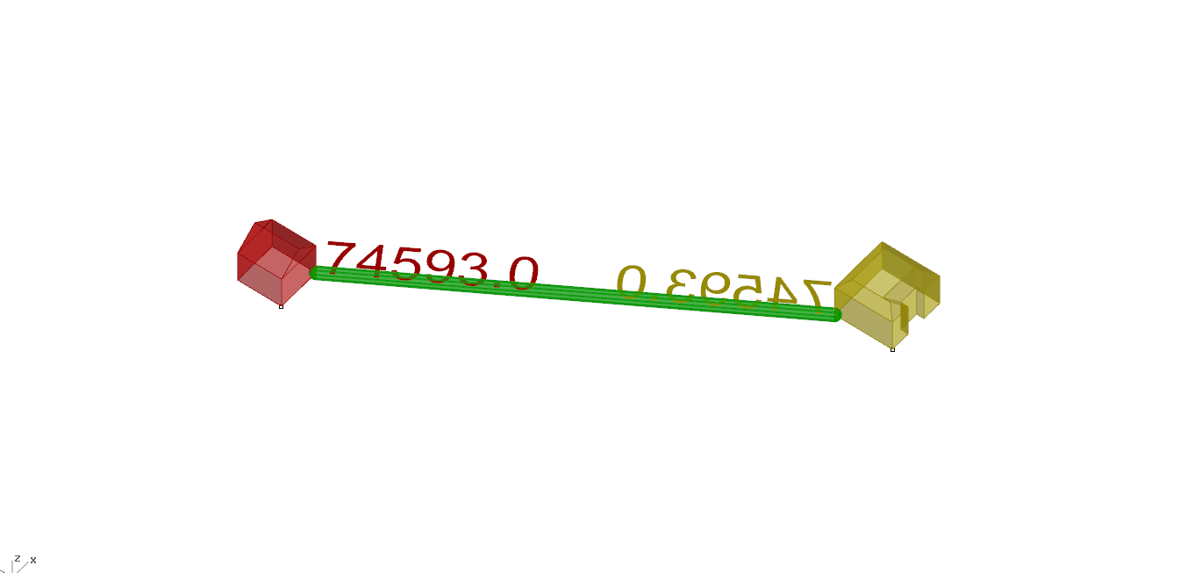
1. The case: personal space
The land value increases when the house gains “personal space”
minimum:
Family home 2 meter
Bungalow 3 meter
Mansion 6 meter
Per meter:
Family home € 285.000, - * 2 % = € 8.550,-
Bungalow € 399.000, - * 3 % = € 15.960,-
Mansion € 610.000, - * 6 % = € 36.600,-

Slide 6
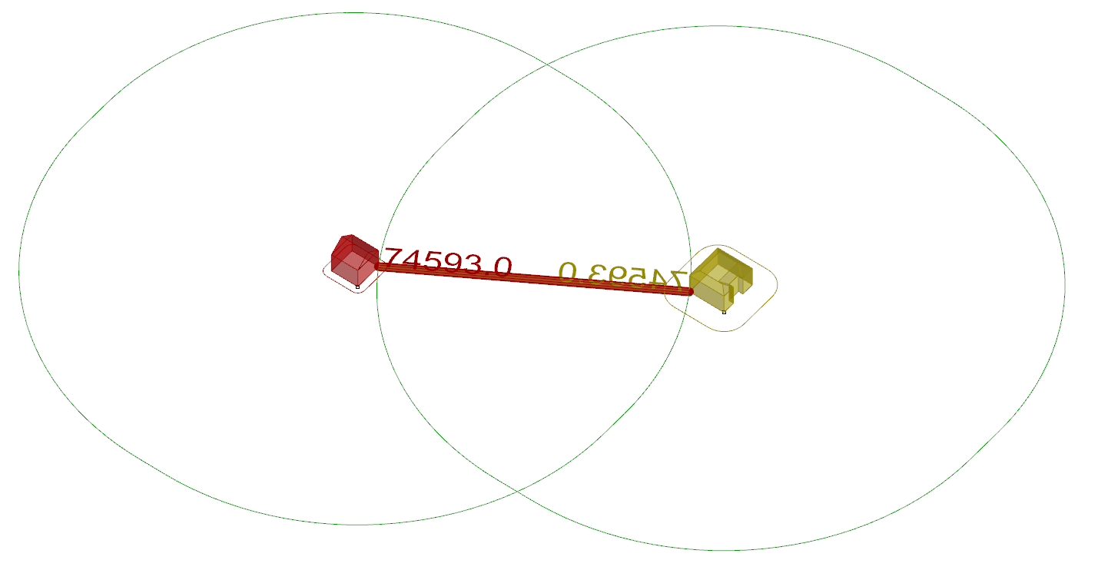
1. The Case: rings
Radius around houses, dubbed rings

Slide 7
2. Orthodox algorithms
Random Algorithm
Hillclimber
random relocater
swap two houses
wiggle through map
prioritise house types
Simulated annealing (WIP)

Slide 8
2. Orthodox: Random
Random algorithm
While(True):
Make a new random map
If new map is better than old map:
Continue with new map
Else:
Continue old one

Slide 9
2. Orthodox: Wiggle
Wiggle Algorithm While(True): For each house on map: increment = 32 meters Move north/ east/ south/ west by increment: If better map value & legal move: Update map Repeat Else: Same_map_value += 1
If Same_map_value => house Increment /= 2 (until it is 0.5 m)

Slide 10
2. Orthodox: Improved
Random relocator
While(True):
Take a random house
Put it in a random position
While the position is invalid or the map is worse:
Try placing house again
If the map is still invalid:
Revert map

Slide 11
2. Orthodox: Swap
Random two house-swapper
While(True):
Take a random house
Take another random house of another type
Switch both houses
While position is invalid or map is worse:
revert
If map is valid and better:
Repeat with this map

Slide 12
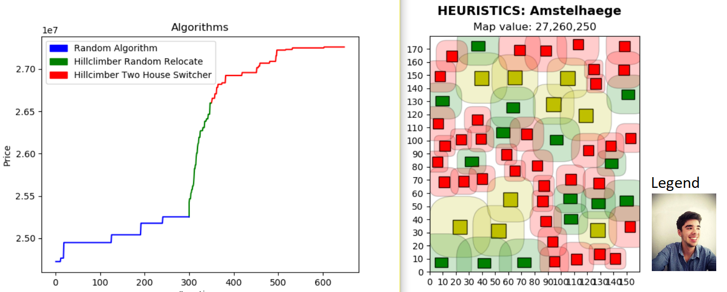
Orthodox algorithms results
meters

Slide 13
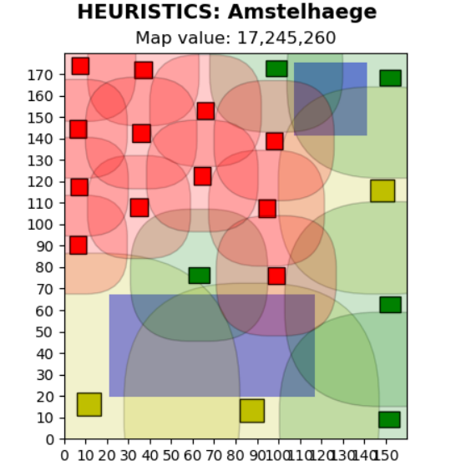
Orthodox algorithms results

Slide 14
3. Unorthodox
Its purpose: create a map with a certain distribution of free space
Realised by:
Local constraint: “Minimal free space”
‘A third type of ring’
Gradually increasing this ring
Testing if it still leads to valid maps
Takes in different ring frequencies
Demo

Slide 15
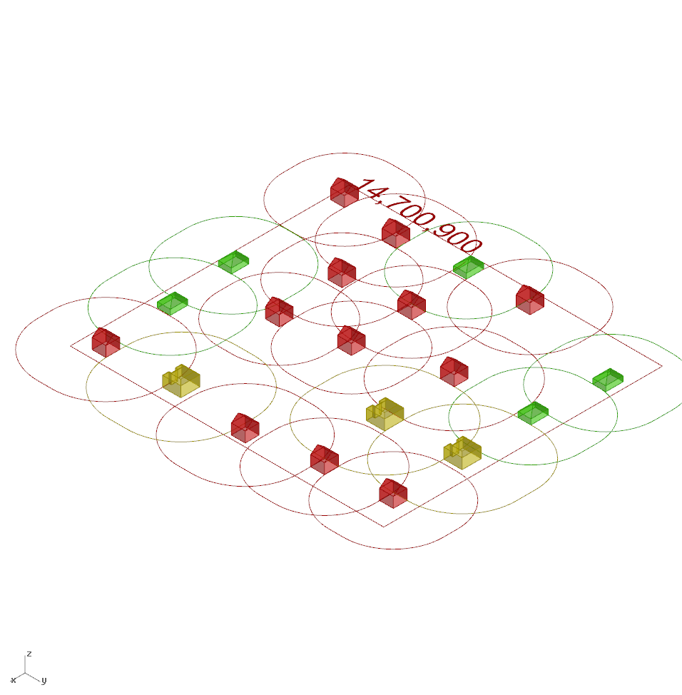
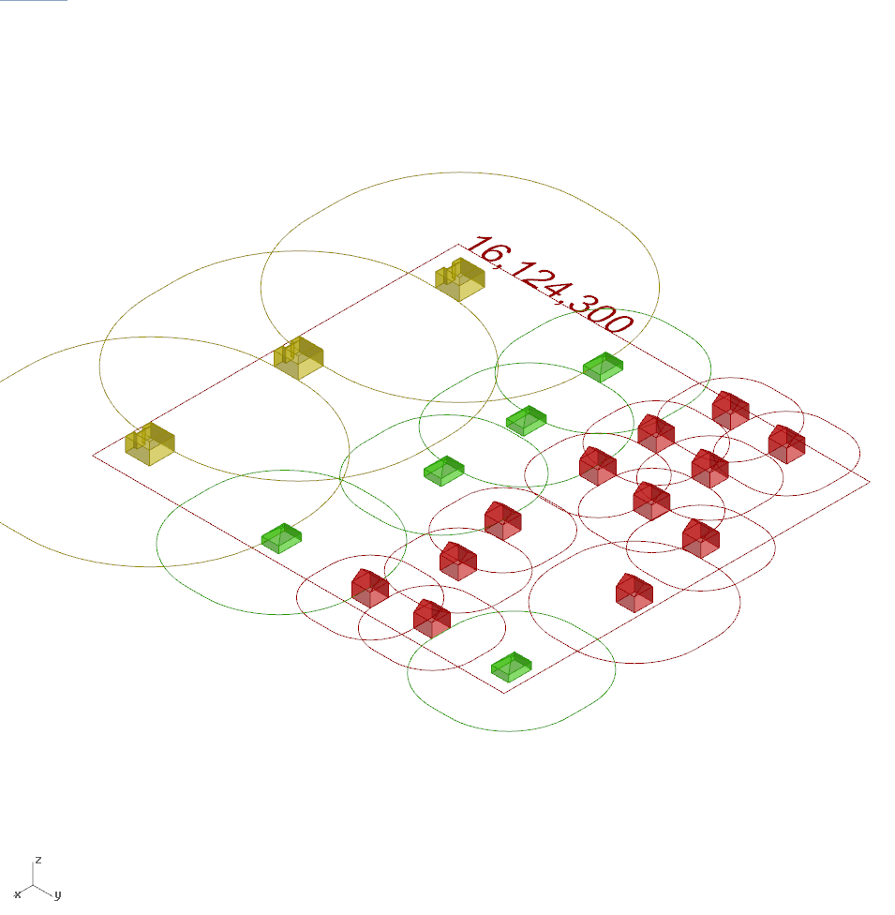
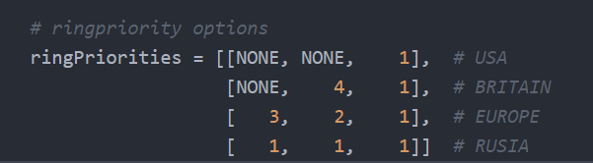
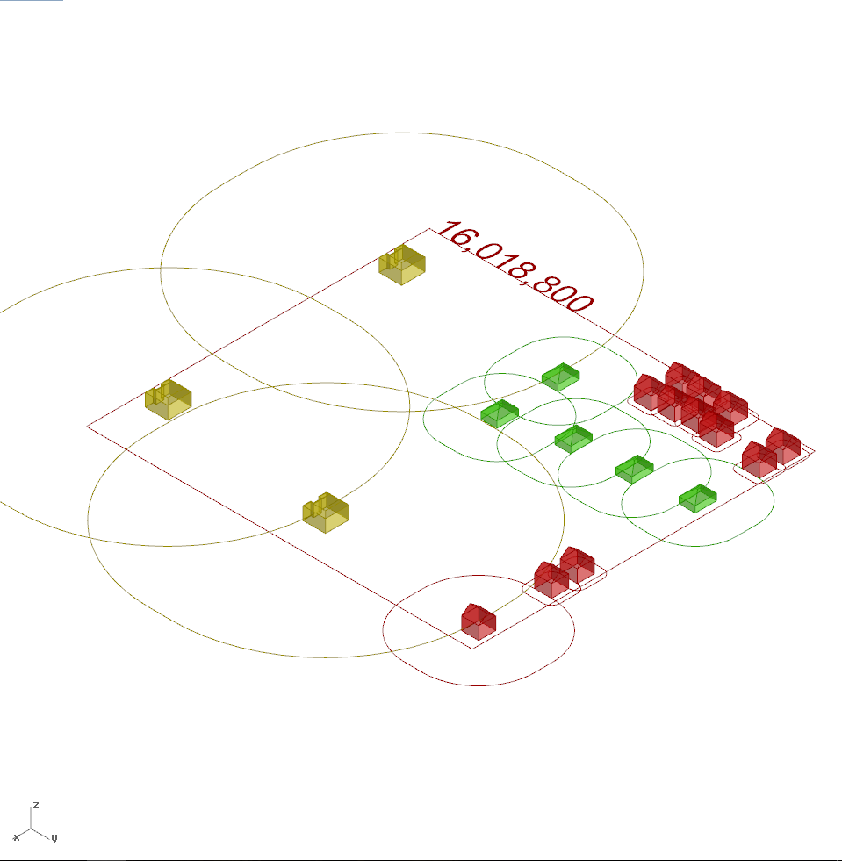
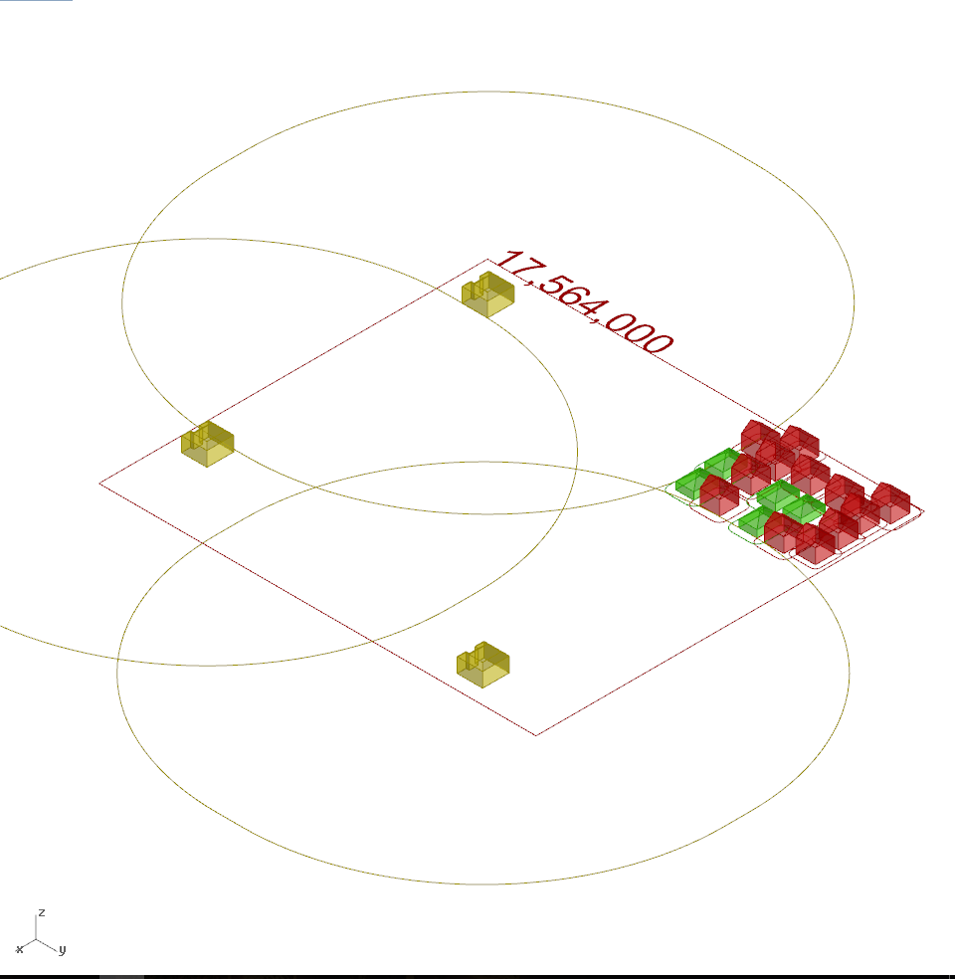
Unorthodox Results:
Russia
Europe
Manual insert ring distribution
(sadly, ) U.S.A. Types maps are the most valuable by a long shot
Gr. Britain
U.S.A.

Slide 16
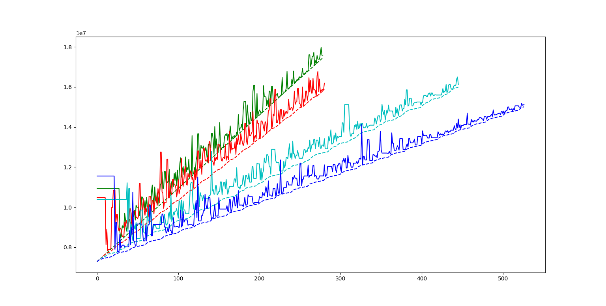
Comparison of different prioritization models
US model
UK model
EU model
USSR model
Map value [euro]
N rings increased

Slide 17
3. Unorthodox: joint effort
demo

Slide 18
TODO
Geman & Geman, simulated annealing
More experimentation and making figures of it
Combine algorithms and compare sequences

